Slide 1

THU Bridge Mobile Application
Prof : Gheorghi Guzun
Chirag Arora
Sai Prasanth Guthula
Sai Vamsi Dutt Patibandla
Jigar Jigneshbhai Shah

Slide 2
Abstract
The THU Bridge mobile application serves as a dynamic solution to the prevalent communication barriers in healthcare settings, particularly those arising from language differences.
It is designed to facilitate seamless interactions between patients, interpreters, and administrators, thereby enhancing the accessibility of healthcare services and improving overall patient satisfaction.
The application is user-friendly, secure, and serves multiple stakeholders in the healthcare system by providing tools to request and manage interpreter services, access appointment schedules, and oversee operations efficiently.

Slide 3
Project Overview
In the era of global health challenges, the importance of robust communication systems in healthcare cannot be overstated.
The THU Bridge app aims to address these challenges by creating an interface that allows for efficient communication between patients who speak different languages and their healthcare providers.
The project's objective is to integrate advanced digital solutions to streamline communication processes, reduce associated costs, and improve the outcomes of healthcare services.

Slide 4
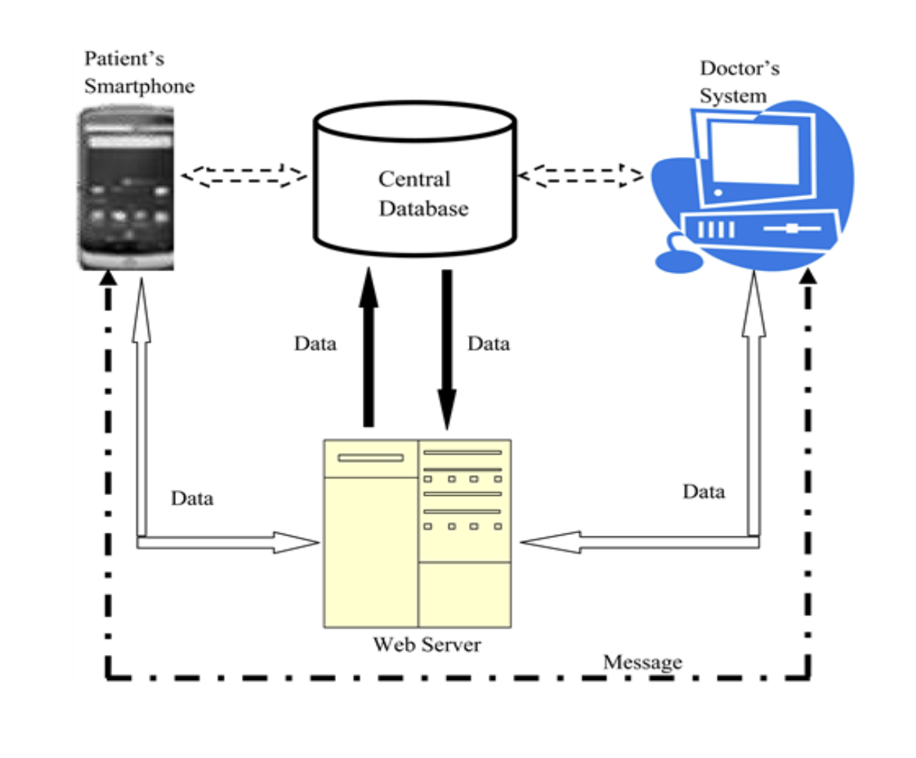
Project Architecture
The architecture of the THU Bridge app is designed with a focus on modularity and scalability.
It consists of three primary layers: the Presentation Layer, which is tailored for maximum user accessibility and ease of use; the Business Logic Layer, which handles all the core functionalities such as scheduling and data management; and the Data Access Layer, which interacts with databases and external APIs to fetch and store necessary data securely.
This structured approach ensures that the application is robust, secure, and capable of evolving over time.

Slide 5
Technology Stack
The THU Bridge app utilizes a combination of cutting-edge technologies to ensure top-notch performance and user experience.
The frontend is developed using React Native, allowing for a consistent look and feel across different platforms, while the backend is powered by Flask and deployed on Heroku for reliable scalability.
PostgreSQL is used for database management due to its robustness.
The application also incorporates Redux for state management, ensuring that the UI is responsive and the user experience is smooth across different components of the app.

Slide 6
User Interface Design
The design of the THU Bridge app prioritizes simplicity and efficiency to accommodate users with varied technical skills.
The interface includes intuitive navigation and clear, accessible menus, allowing users to easily schedule appointments, request interpreters, and manage their profiles.
Design consistency is maintained throughout the application to ensure a seamless user experience, with Material-UI components used to adhere to modern design standards.

Slide 7
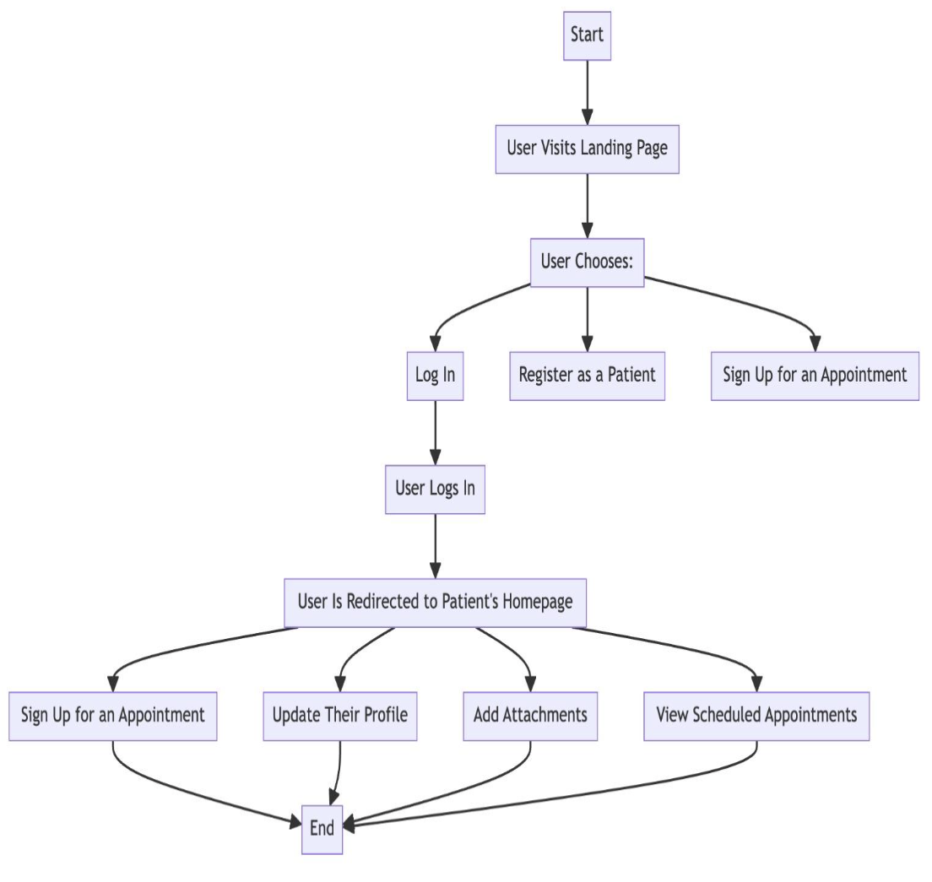
Implementation and Features
Key features of the THU Bridge app include real-time appointment scheduling, comprehensive management of interpreter services, and detailed user profiles that enhance personalization and accessibility.
Security is a paramount concern, addressed through the integration of Auth0 for robust authentication processes.
Local storage solutions are implemented to enhance application performance and user experience, keeping essential data readily available without repeated server calls.

Slide 8
Testing and Verification
Extensive testing phases ensure the application meets all functional and performance standards. This includes functional testing to verify core capabilities, compatibility testing across different devices, usability testing to ensure the interface meets user expectations.
Each testing phase is critical for refining the application and ensuring it operates reliably under various conditions.

Slide 9
Summary and Future Directions
The THU Bridge app significantly improves healthcare communication by facilitating better interaction among patients, interpreters, and healthcare administrators.
The successful deployment of the app sets a benchmark for future developments in healthcare communication technology.
Looking forward, the project aims to expand its reach globally, enhancing features to support an even broader user base and integrating further technological advancements.

Slide 10
THANK YOU

